Slide 1
Genetic Algorithm for Boolean Minimization in an FPGA Cluster
Assignment II
By Kartikay Kaul 16BCE1057

Slide 2
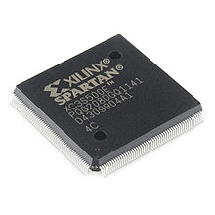
FPGA Brief
Field Programmable Gate Arrays
Semiconductor devices that are based around a matrix of configurable logic blocks connected via programmable interconnects
Can be reprogrammed – distinguishes them from ASICs
Applications in many industries such as Aerospace and Defence, Automotive, Data Centers, Consumer Electronics, etc

Slide 3
Introduction
Genetic algorithms are most popular approach for evolutionary algorithms
They help solve NP-problem
Natural selection where only best adapted survives
Genetic Programming is used to synthesize combinational circuits
GP presents interesting advantages such as the capacity to guide the algorithm search with design restrictions like area, critical path or power consumption, obtaining solutions that could not be reached with traditional synthesis methods.

Slide 4
Overcoming scalability problem
To overcome the scalability problem of GP the given paper has presented a new approach for GP based on HPRC architecture called SMILE
SMILE is a cluster of FPGAs connected using Gigabit Ethernet and makes use of parallel programming as well as co-design.
Takes advantage from double level of parallelism
Course-grain parallelism
Fine-grain parallelism
The system is able to synthesize circuits upto 12 variables with x500 speedup against a supercomputer while maintain scalability

Slide 5
Background
Simple Genetic Algorithm (https://medium.com/@gabogarza/simple-genetic-algorithm-6d6aafcc310a)
Natural selection in the real world optimizes for survival on Earth.
VGAs (https://www.researchgate.net/publication/220741828_Variable_Length_Genomes_for_Evolutionary_Algorithms)

Slide 6
Issues with these Algorithms
Evolution time
High computational requirement for implementing a bio-inspired algorithm
As a result only small circuits can be created in reasonable time
To solve this scalability restriction of creating digital circuits by using PGP and FPGA cluster-based architecture has been developed
4 FCU on each FPGA helps accelerate convergence of algorithm AND provides support for 12 variable synthesis

Slide 7
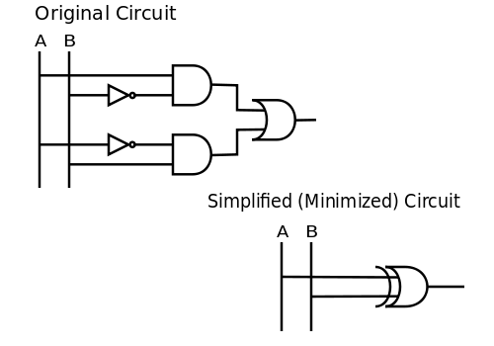
Boolean Synthesis
Design flow process that optimizes and reduces the logic gate nets of a circuit in order to minimize costs, chip area and increase performance
GP programming is deployed for Boolean synthesis
GP does not distinguish search space nor representation space of individual and helps create new operators.
String of bits are called as Chromosomes (Hardware Representation)

Slide 8
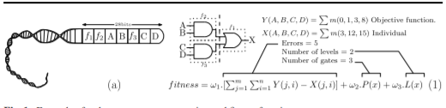
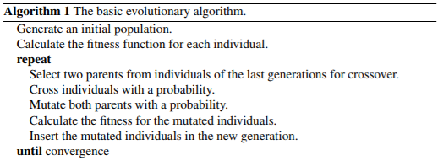
Boolean Synthesis
Chromosome Representation. Is the way a logic circuit is represented using a bit array in order to be managed in evolution process
Fitness Function. Responsible for quantifying the way a chromosome or individual meets or not the requirements
Genetic Operators. Selection operator is responsible for identifying the best individuals of the population taking into account the exploitation and the exploration

Slide 9

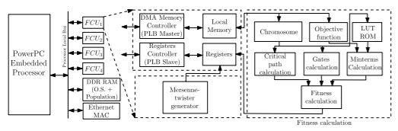
SMILE CLUSTER
16 FPGA nodes and a host computer monitoring cluster operation
Gigabit ethernet used for communication between the boards
DDR-SRAM controller, System ACE controller

Slide 10
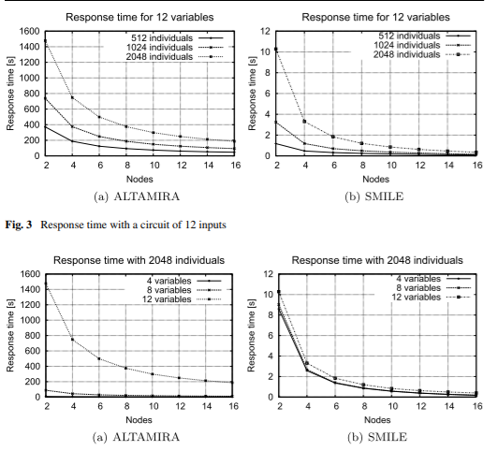
Evaluation of this architecture

Slide 11
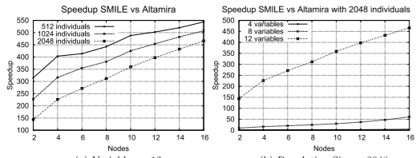
End Note
Alternative approach was presented for combination synthesis using PGP
An FPGA cluster was compared in performance to an HPC cluster
In order to accelerate the process, a coprocessor was implemented to calculate the fitness function and to generate random numbers

